Slide 1
http://catapp.in
CATapp – Preparation on the Go
by

Slide 2
agenda
Project Overview
What problem are we trying to solve?
Our solution approach
App Demo & Features
Technology Overview
Usage Statistics
Future Plan

Slide 3
Project Overview
CATapp is a mobile application available on Android/iOS to help students prepare for competitive exams
We are done with Android implementation and are currently working to update the iOS app
We have a web based publishing platform as our backend system, currently used by our partner publishers. ^{BETA}
For this presentation we will focus on the Android app
Primary Functionality: Test Taking
Secondary Features: QuestionADay, CATNews & Toppers Say

Slide 4
What problems are we trying to solve?
Limited access to study material
Students do not have easy access to study material beyond their physical reach
Students do not have a way to get latest content from
publishers & teachers across multiple locations
Making it affordable for students to access global content
Not all students can afford a computer
Not all students can afford to go to a coaching institute
Android phones are now available for as low as Rs 4,500

Slide 5
What problems are we trying to solve?
How can students prepare for competitive exams on mobile?
Take practice tests
Practice solving questions
Analyze progress reports
Learn by reading accurate solutions
Learn more about the exam
Learn from topper’s experience
How can students get new content from multiple publishers?
New question papers
New questions
News updates

Slide 6
Our solution approach
Develop Android & iOS mobile apps
Android & iOS are quickly gaining market share
Cheaper Android devices broadens our target audience
Apps support a wide range of devices – Phones & Tablets
Allow students to study on the go
Develop a web based publishing platform to manage content
Mobile apps have API based access to updated content
Allow multiple publishers to contribute content
Store users’ data on cloud to save space on the device
Easily upload new content & send notifications for the same

Slide 7
Our solution approach
PUBLISHERS /
TEACHERS
Upload latest content
CONTENT MANAGEMENT
PUBLISHING PLATFORM WEB-APP
Download latest content
PHONES & TABLETS

Slide 8
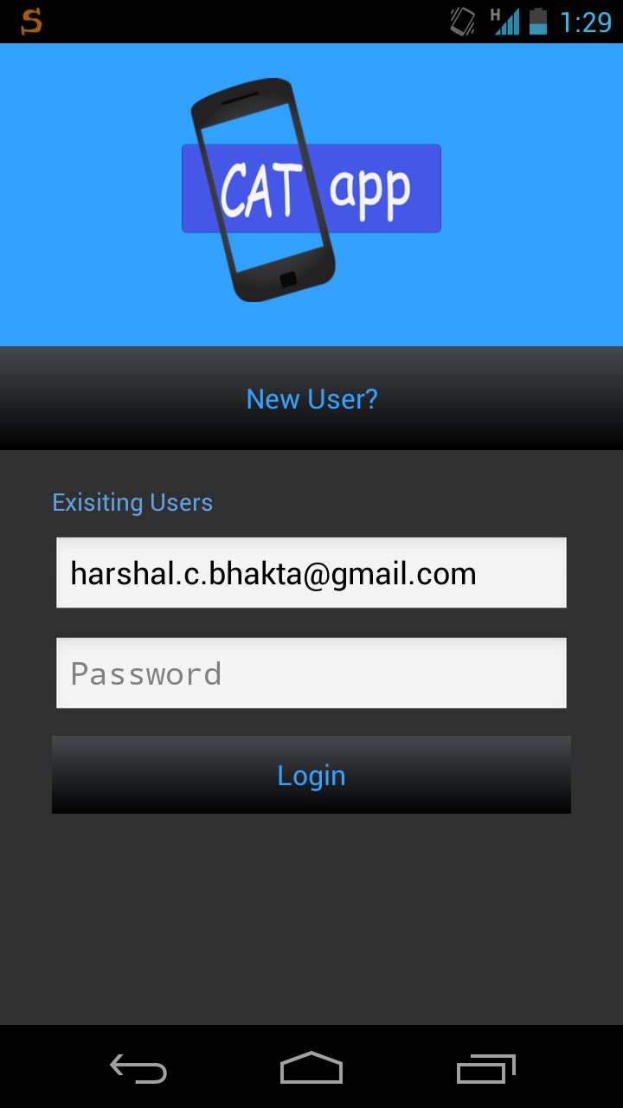
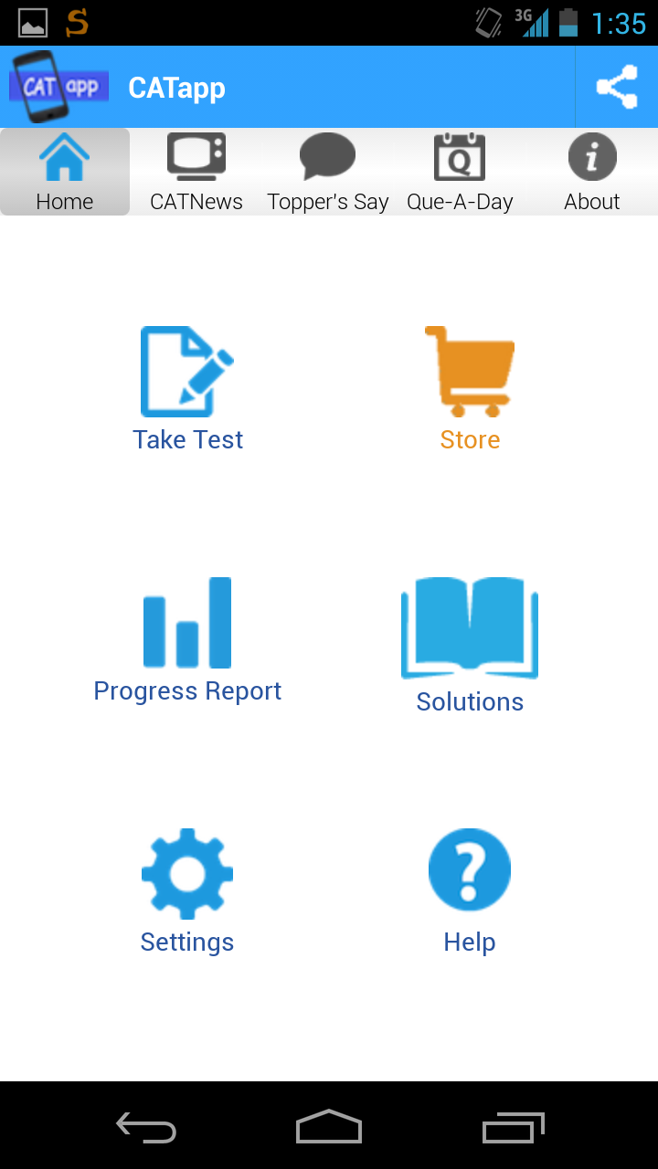
App Demo & Features
LOGIN / REGISTER
HOME SCREEN

Slide 9
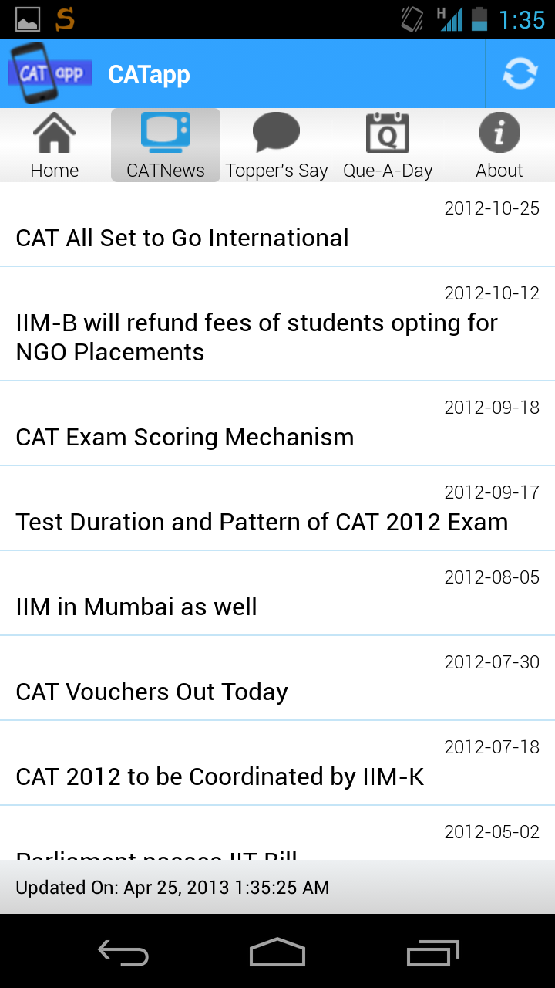
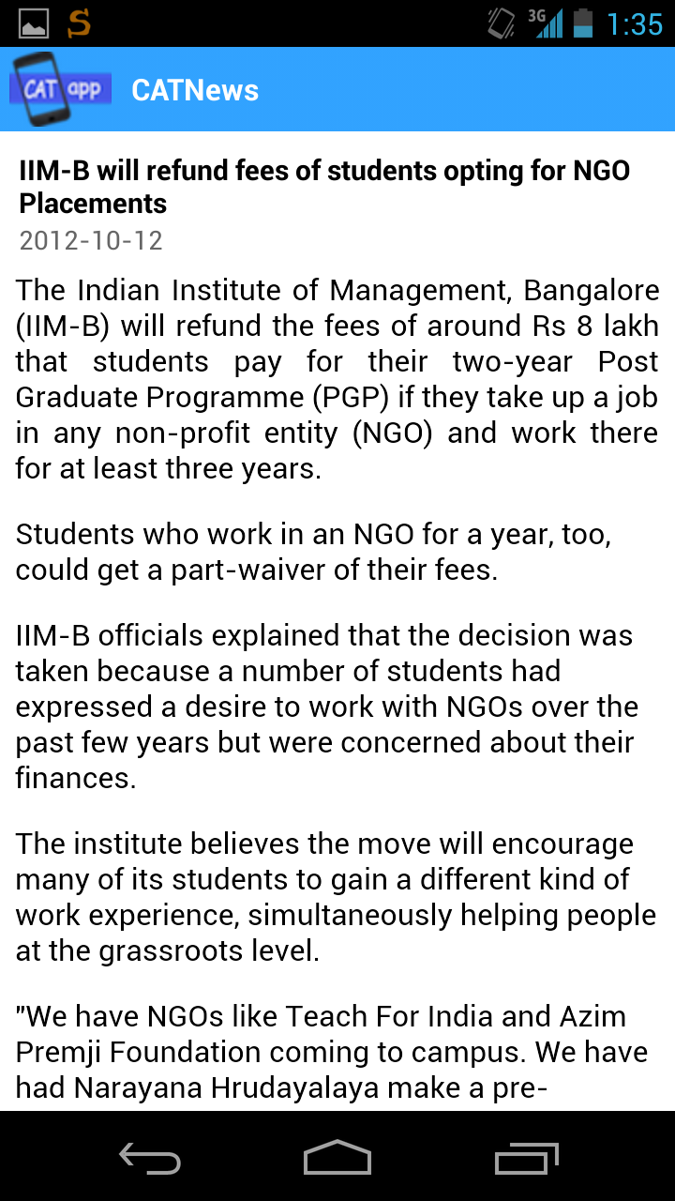
App Demo & Features
CATNews
( List screen & News article screen )
List of news articles published from our backend system
Automatic update when the user first visits CATNews tab
Users can also manually update to get new articles

Slide 10
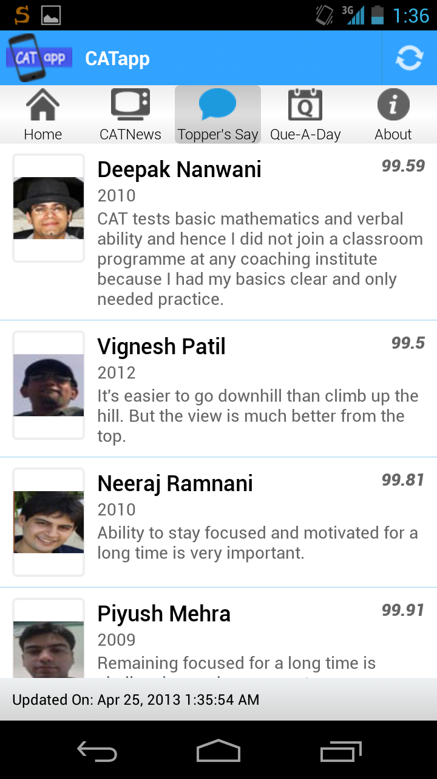
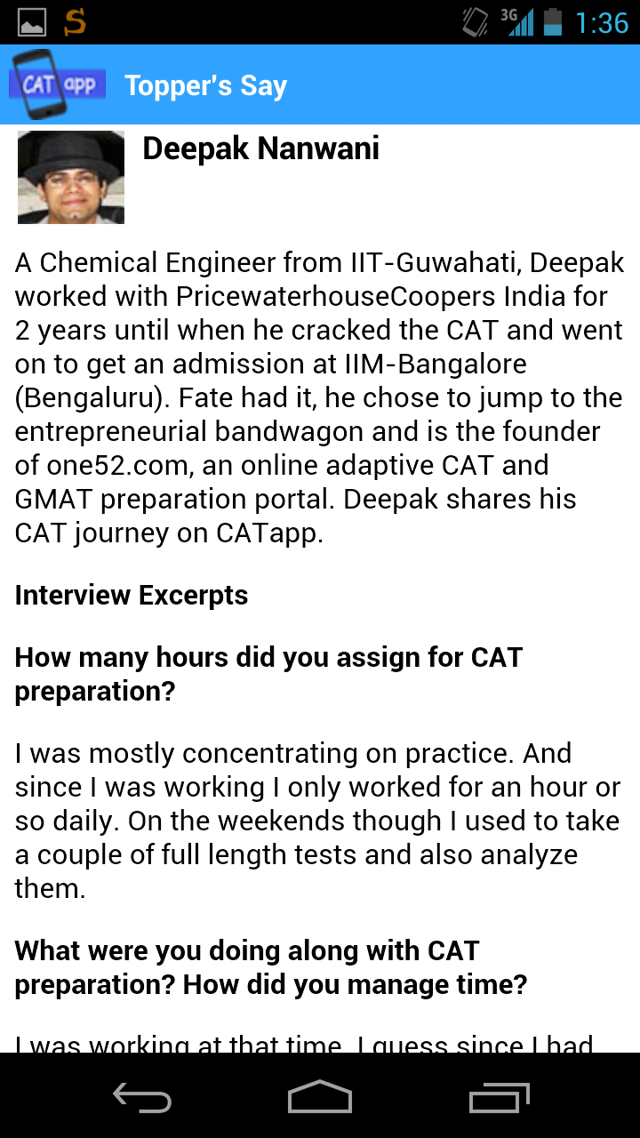
App Demo & Features
Toppers Say
( List screen & Toppers article screen )
List of Topper’s articles published from our backend system
Users can read preparation advise from actual toppers
Detailed Q/A interviews of toppers are published

Slide 11
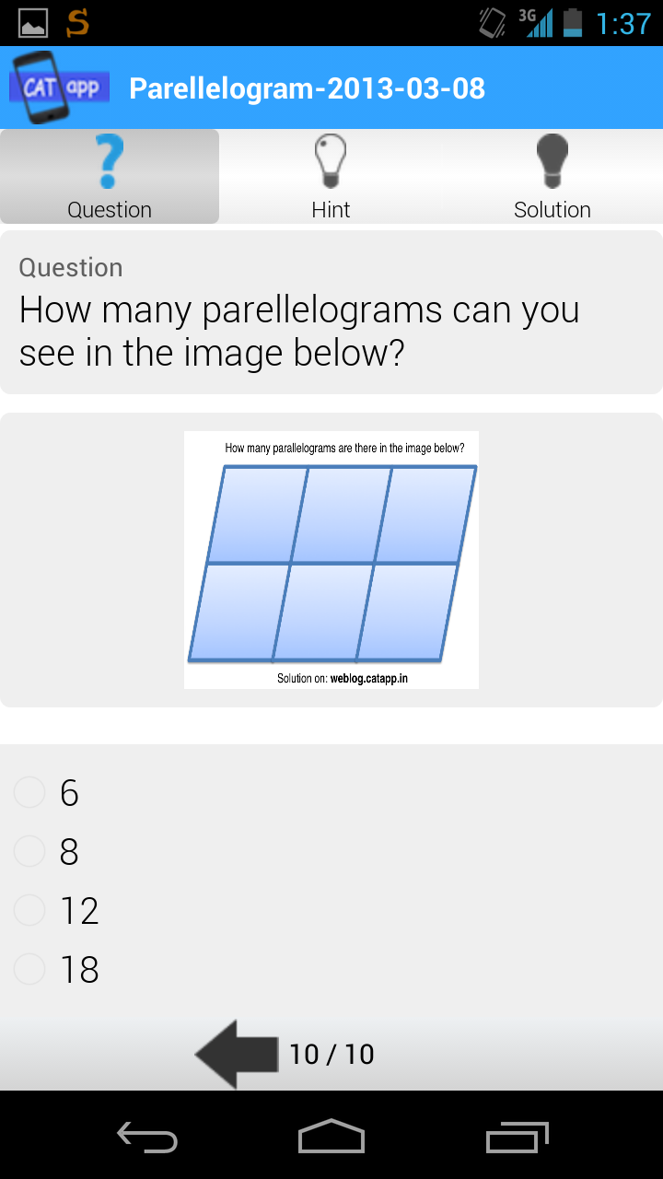
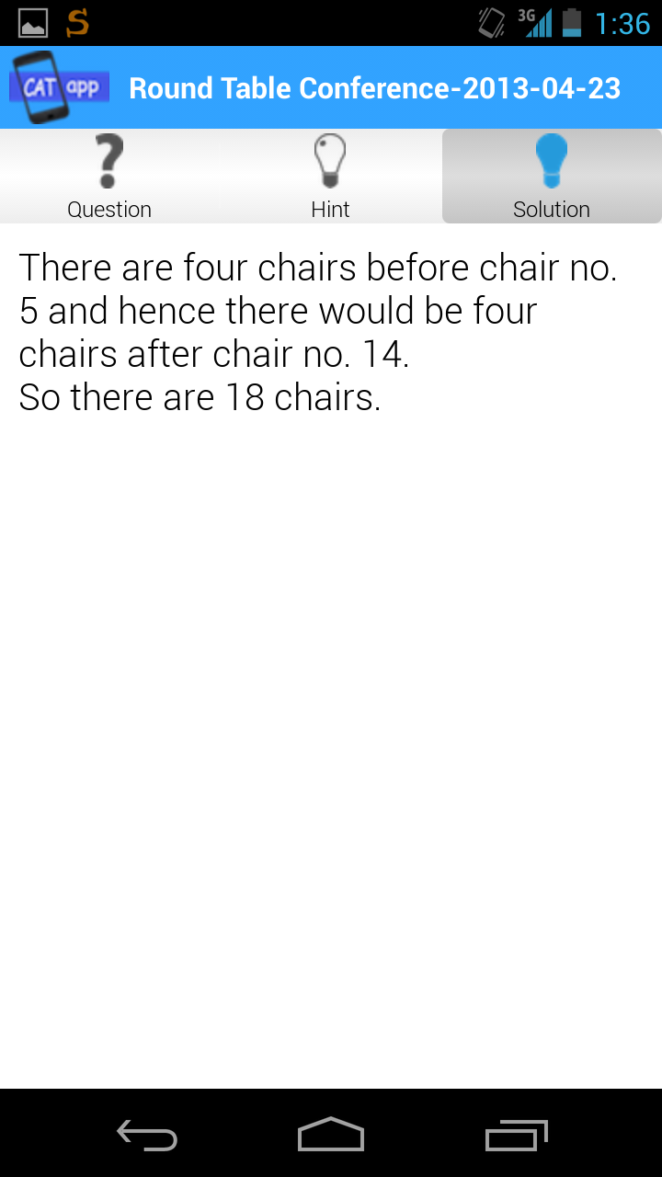
App Demo & Features
QueADay
( A new question every day ☺ )
A new question is published everyday
Users can try to solve the question & discuss on our FB page
Users can check the solution of the question on next day

Slide 12
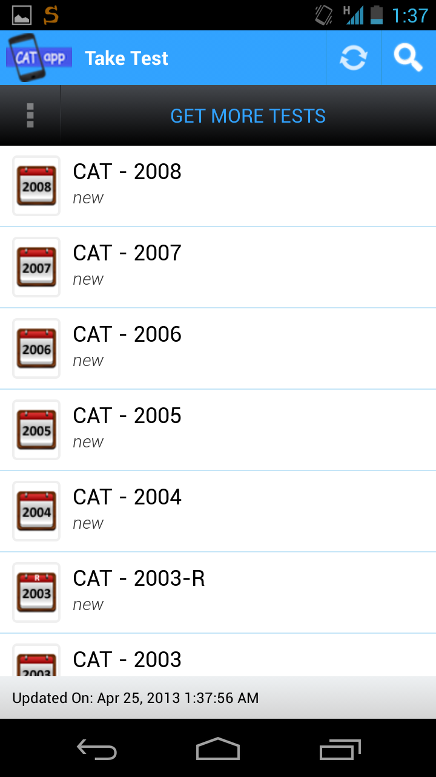
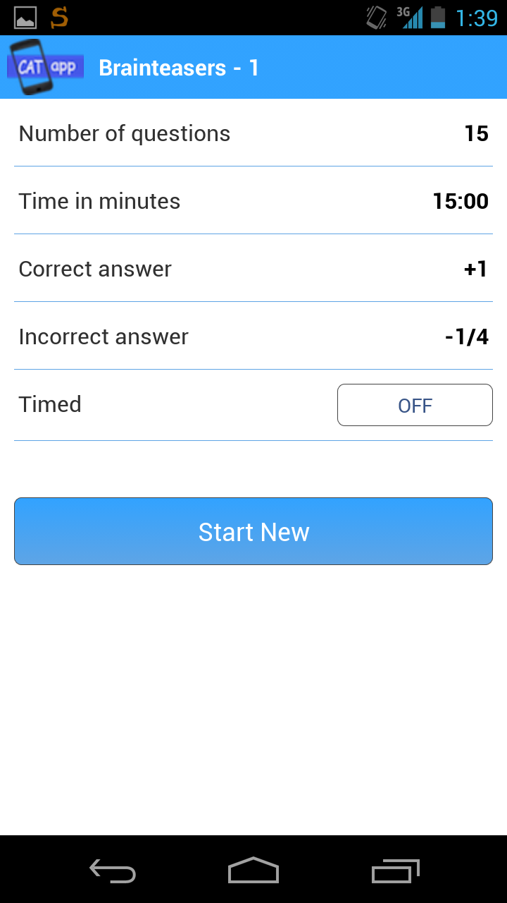
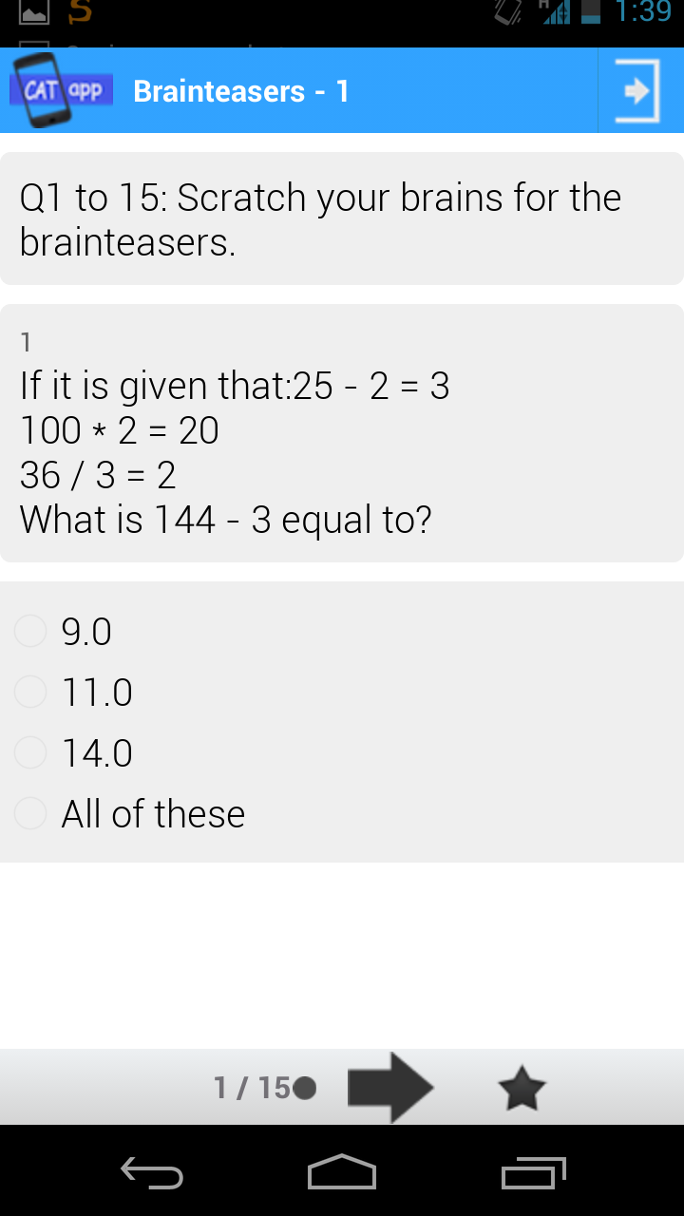
App Demo & Features
Test taking experience - 1
We started the app by focusing on CAT exams
16 original CAT papers are preloaded with solutions
Users don’t need internet connection to take these tests

Slide 13
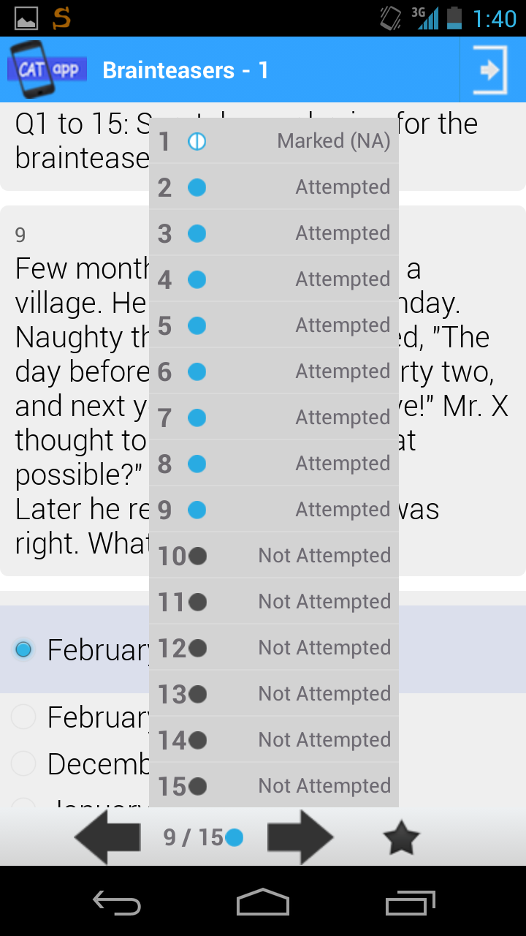
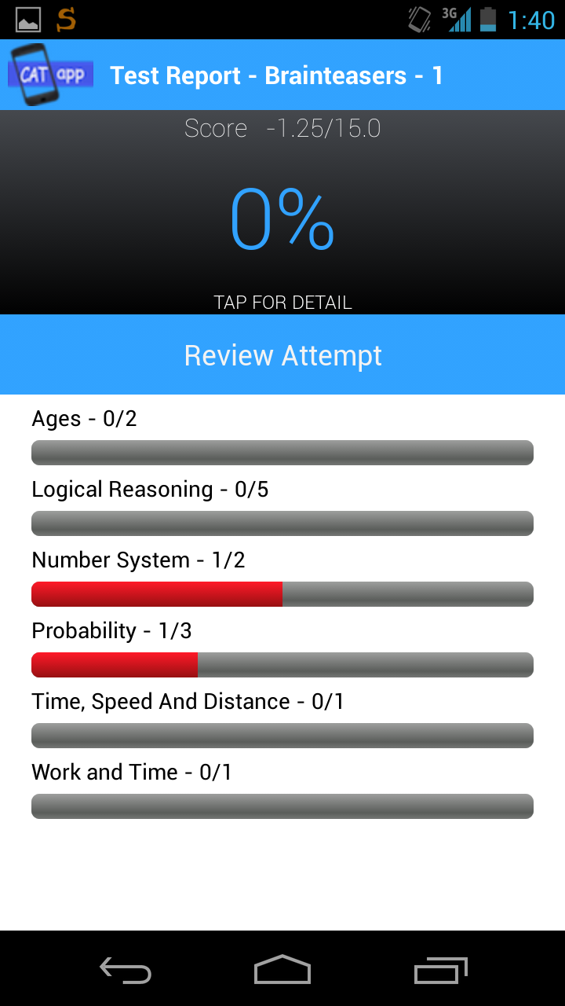
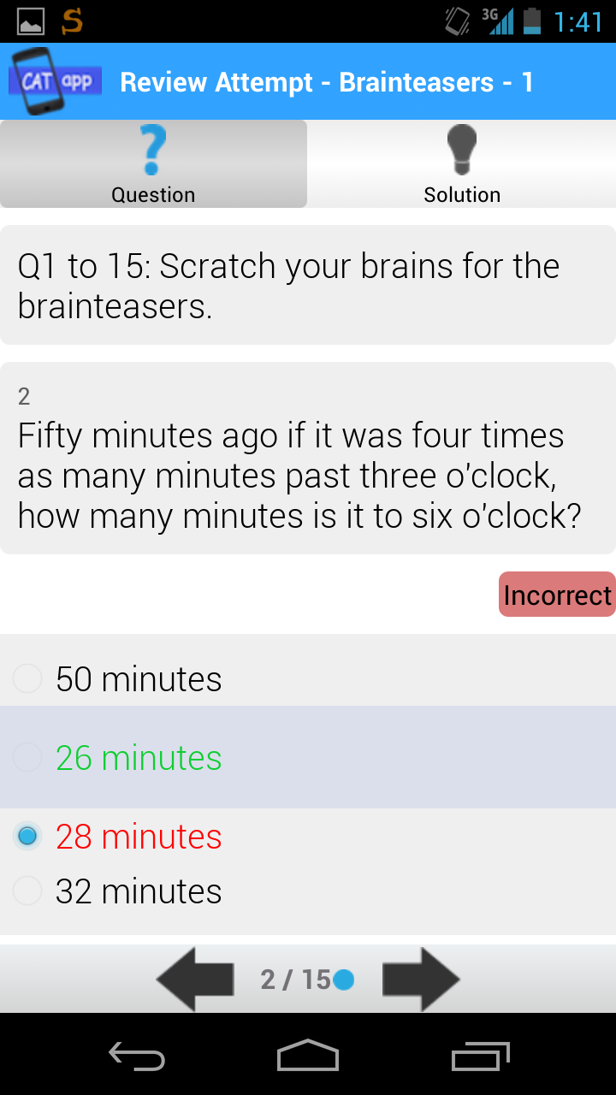
App Demo & Features
Test taking experience - 2
Users can mark questions for review
Detailed progress report generated at the end of test
Progress report shows user’s weak categories
Users can review their attempts and check solutions

Slide 14
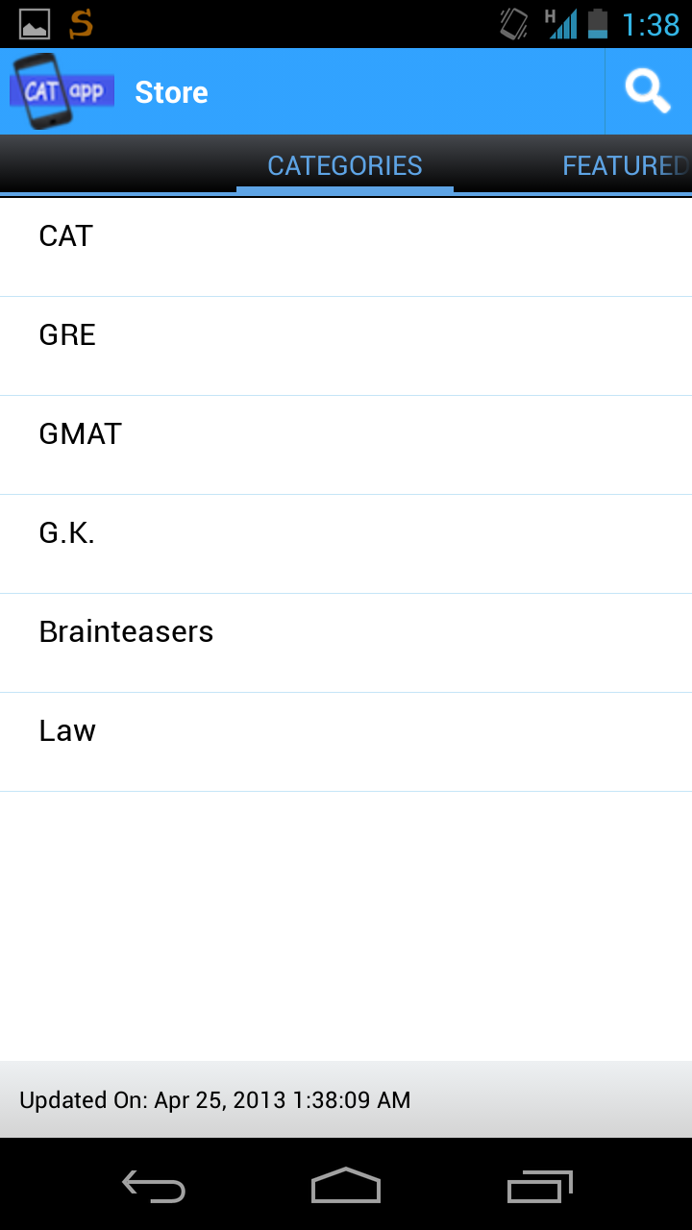
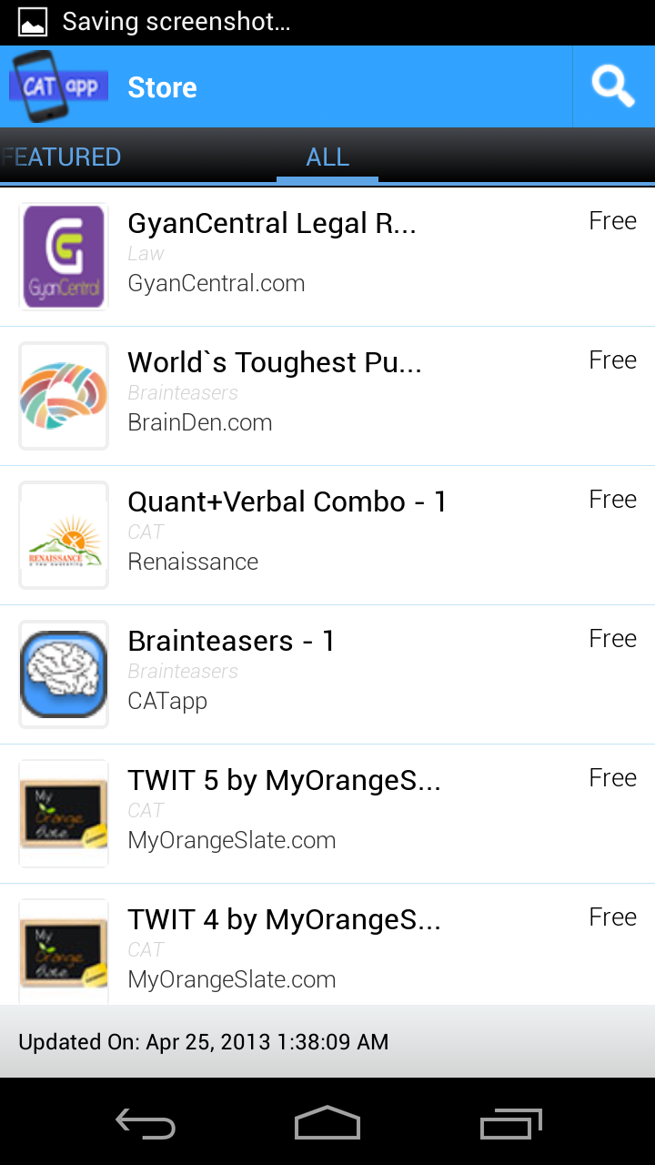
App Demo & Features
Store - 1
Users can access store to download new question papers
Users can also browse the store by choosing a category
Tests from multiple publishers are available in the store
We also feature popular test on the store’s home screen

Slide 15
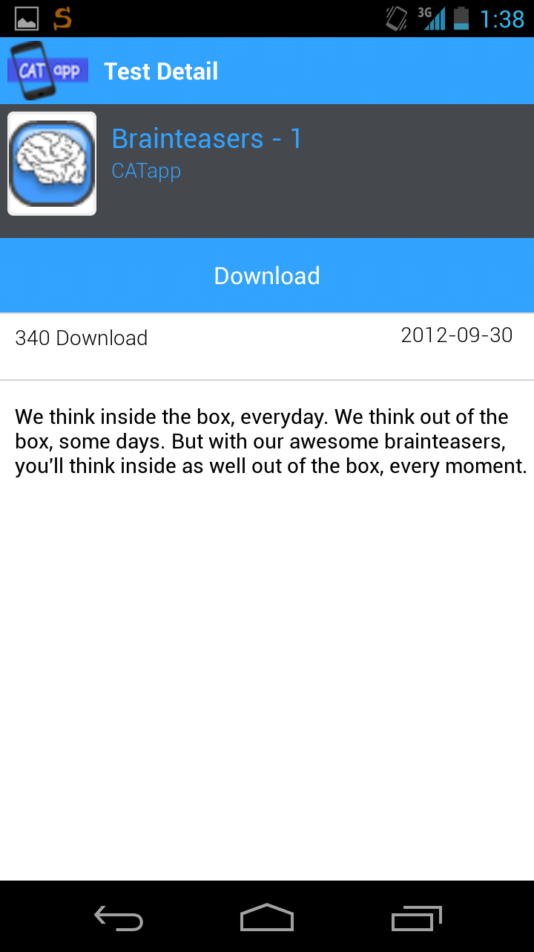
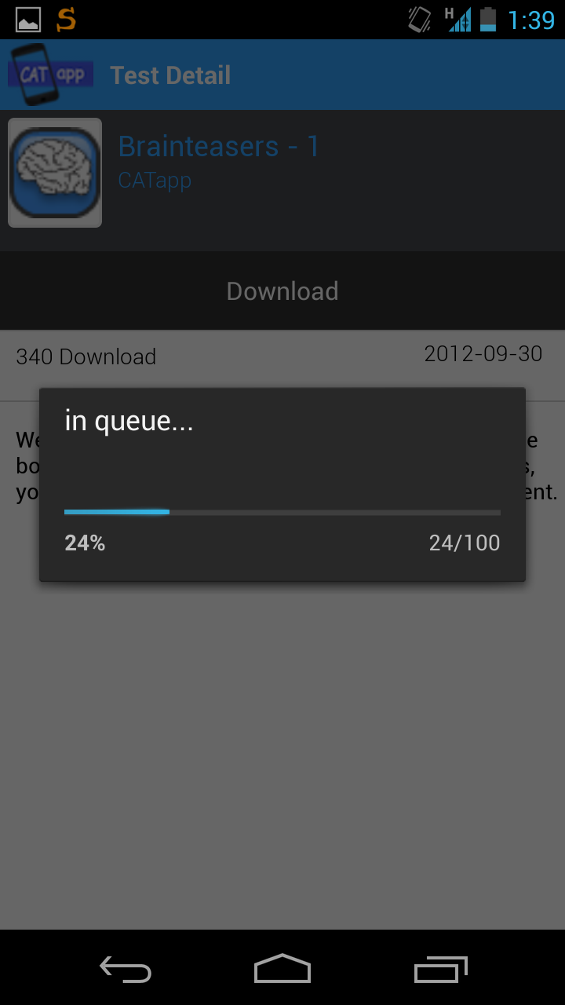
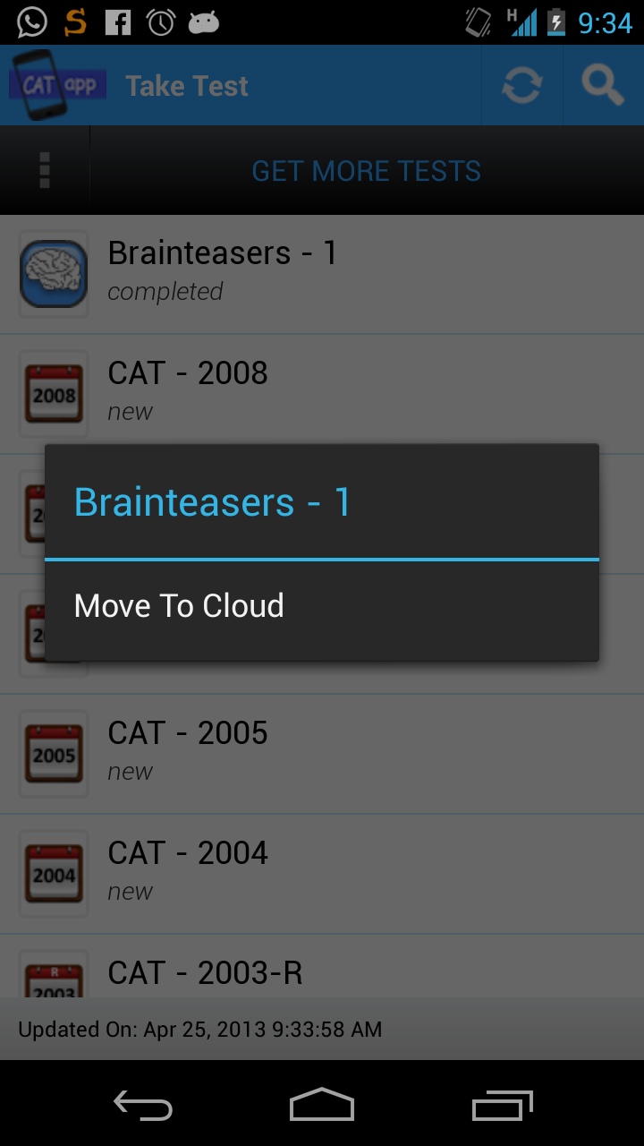
App Demo & Features
Store - 2
Users can view details of a test before downloading
Once downloaded the user can take test without internet
Users can pause the test & continue it later
“Move to cloud” lets user store data on our cloud

Slide 16
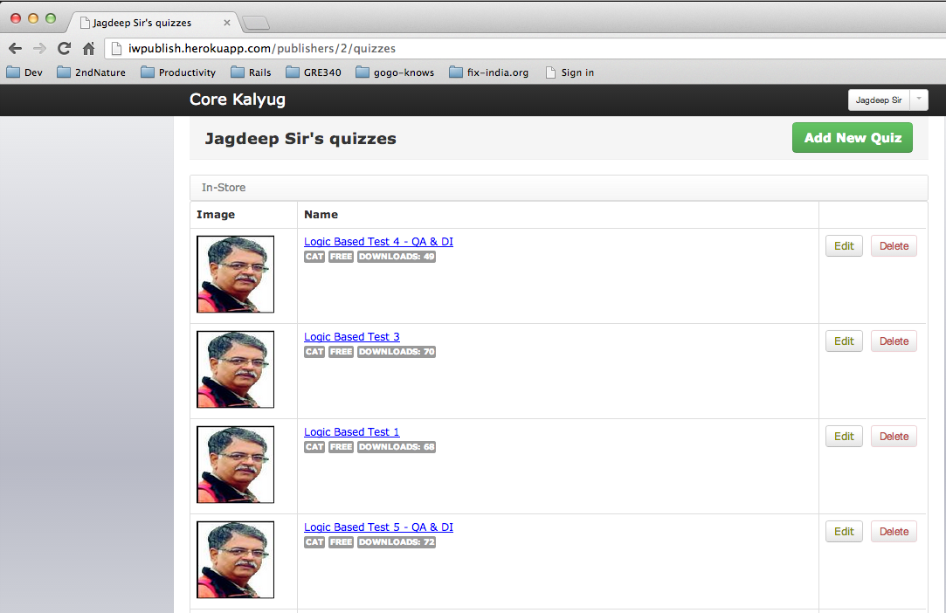
App Demo & Features
BACKEND SYSTEM ^{BETA}

Slide 17
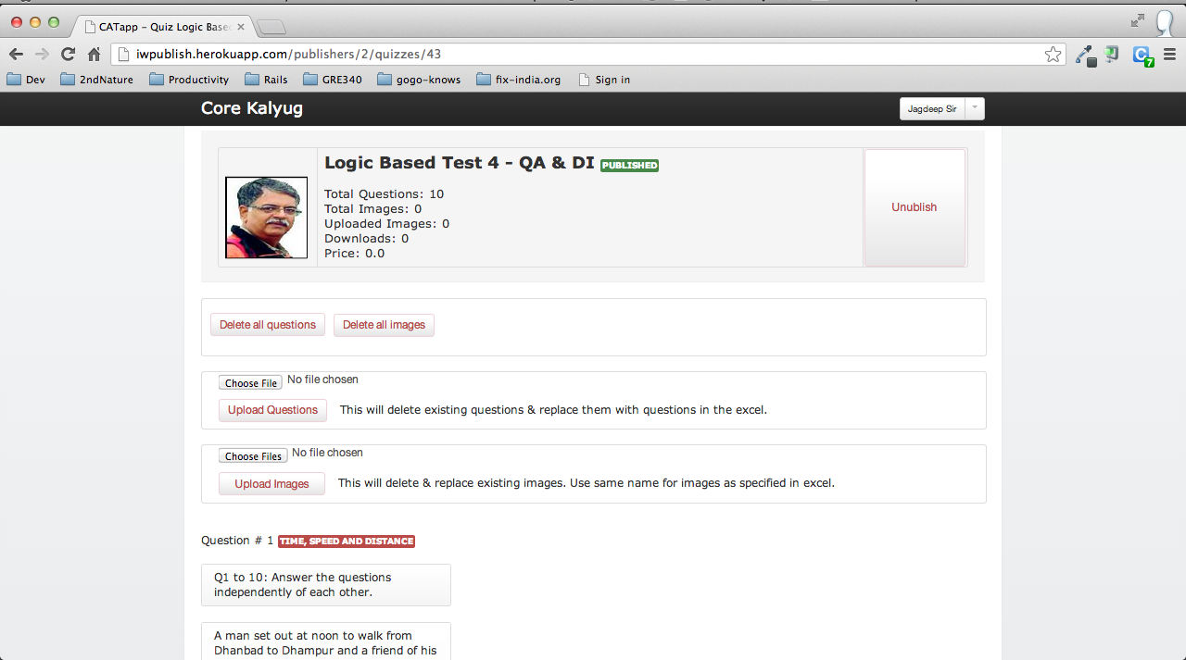
App Demo & Features
BACKEND SYSTEM ^{BETA}

Slide 18
App Demo & Features
Extra features & functionalities
Users can pause test on one device, move to cloud and continue the test on a different device
Users can store their progress report & test data on cloud to save space on their device
Users can take test in timed & untimed mode
Users can directly study solutions if they prefer to do so
Users can see a summary progress report of all the tests
Users can access our app from multiple devices and get the same experience for their user login
We have implemented in-app notifications using Google GCM service to send regular updates to the users

Slide 19
Technology Overview
Mobile Platform
Android
iOS
SQLite for offline storage
Data Integrity: MD5 Hash
Web Platform
Framework: Ruby on Rails
Deployment Platform: Heroku
Database: PostgreSQL
Assets Storage: Amazon S3

Slide 20
Usage Statistics
Android
Launch date: 15-Apr-2012
Total number of users as of 22-Apr-2013: 8,777
Average number of downloads / day: 25
Average user ratings: 4.83 / 5.00
iOS
Launch date: 15-Apr-2012
Total number of users as of 22-Apr-2013: 1,607
Average number of downloads / day: 5
Average user ratings: 5.00 / 5.00

Slide 21
CONTENT PROVIDERS
In-house Content Team
CATapp in-house team works on creating quality question papers across various domains like CAT, GK & Aptitude
MyOrangeSlate.com
MyOrangeSlate.com by Four Pebbles Edu Solutions Pvt Ltd. is the new way to prepare for exams like CAT, GMAT, GRE, CMAT, etc.
BrainDen.com
FREE BRAIN TEASERS FOR KIDS AND ADULTS

Slide 22
CONTENT PROVIDERS
Renaissance
Coaching institute based out of Ahmedabad specializing in CAT, GRE & GMAT preparation.
Prof. Jagdeep Vaishnav
Freelance publisher specializing in Logic based tests.

Slide 23
Usage Statistics
Steadily approaching 10,000 downloads on Android.
We started CATapp focusing on just the CAT exam.
Response seems good taking into account the number of
people having Android devices taking CAT exam.
We are in process of putting up content for other
competitive exams to broaden our user base.

Slide 24
Future Plan
Turn CATapp into a community driven testing app
Enlighten users about sharing knowledge on CATapp.
Partner with educational institutes for question papers.
Publish content for other competitive exams.
Develop features to let people collaborate with others
taking the same exam.
Open up the publishing platform for independent users
Users will be able to post new questions, news & articles.

